Slide 1
Spacey ERD
Presented by : 1705096
Group No : 2

Slide 2
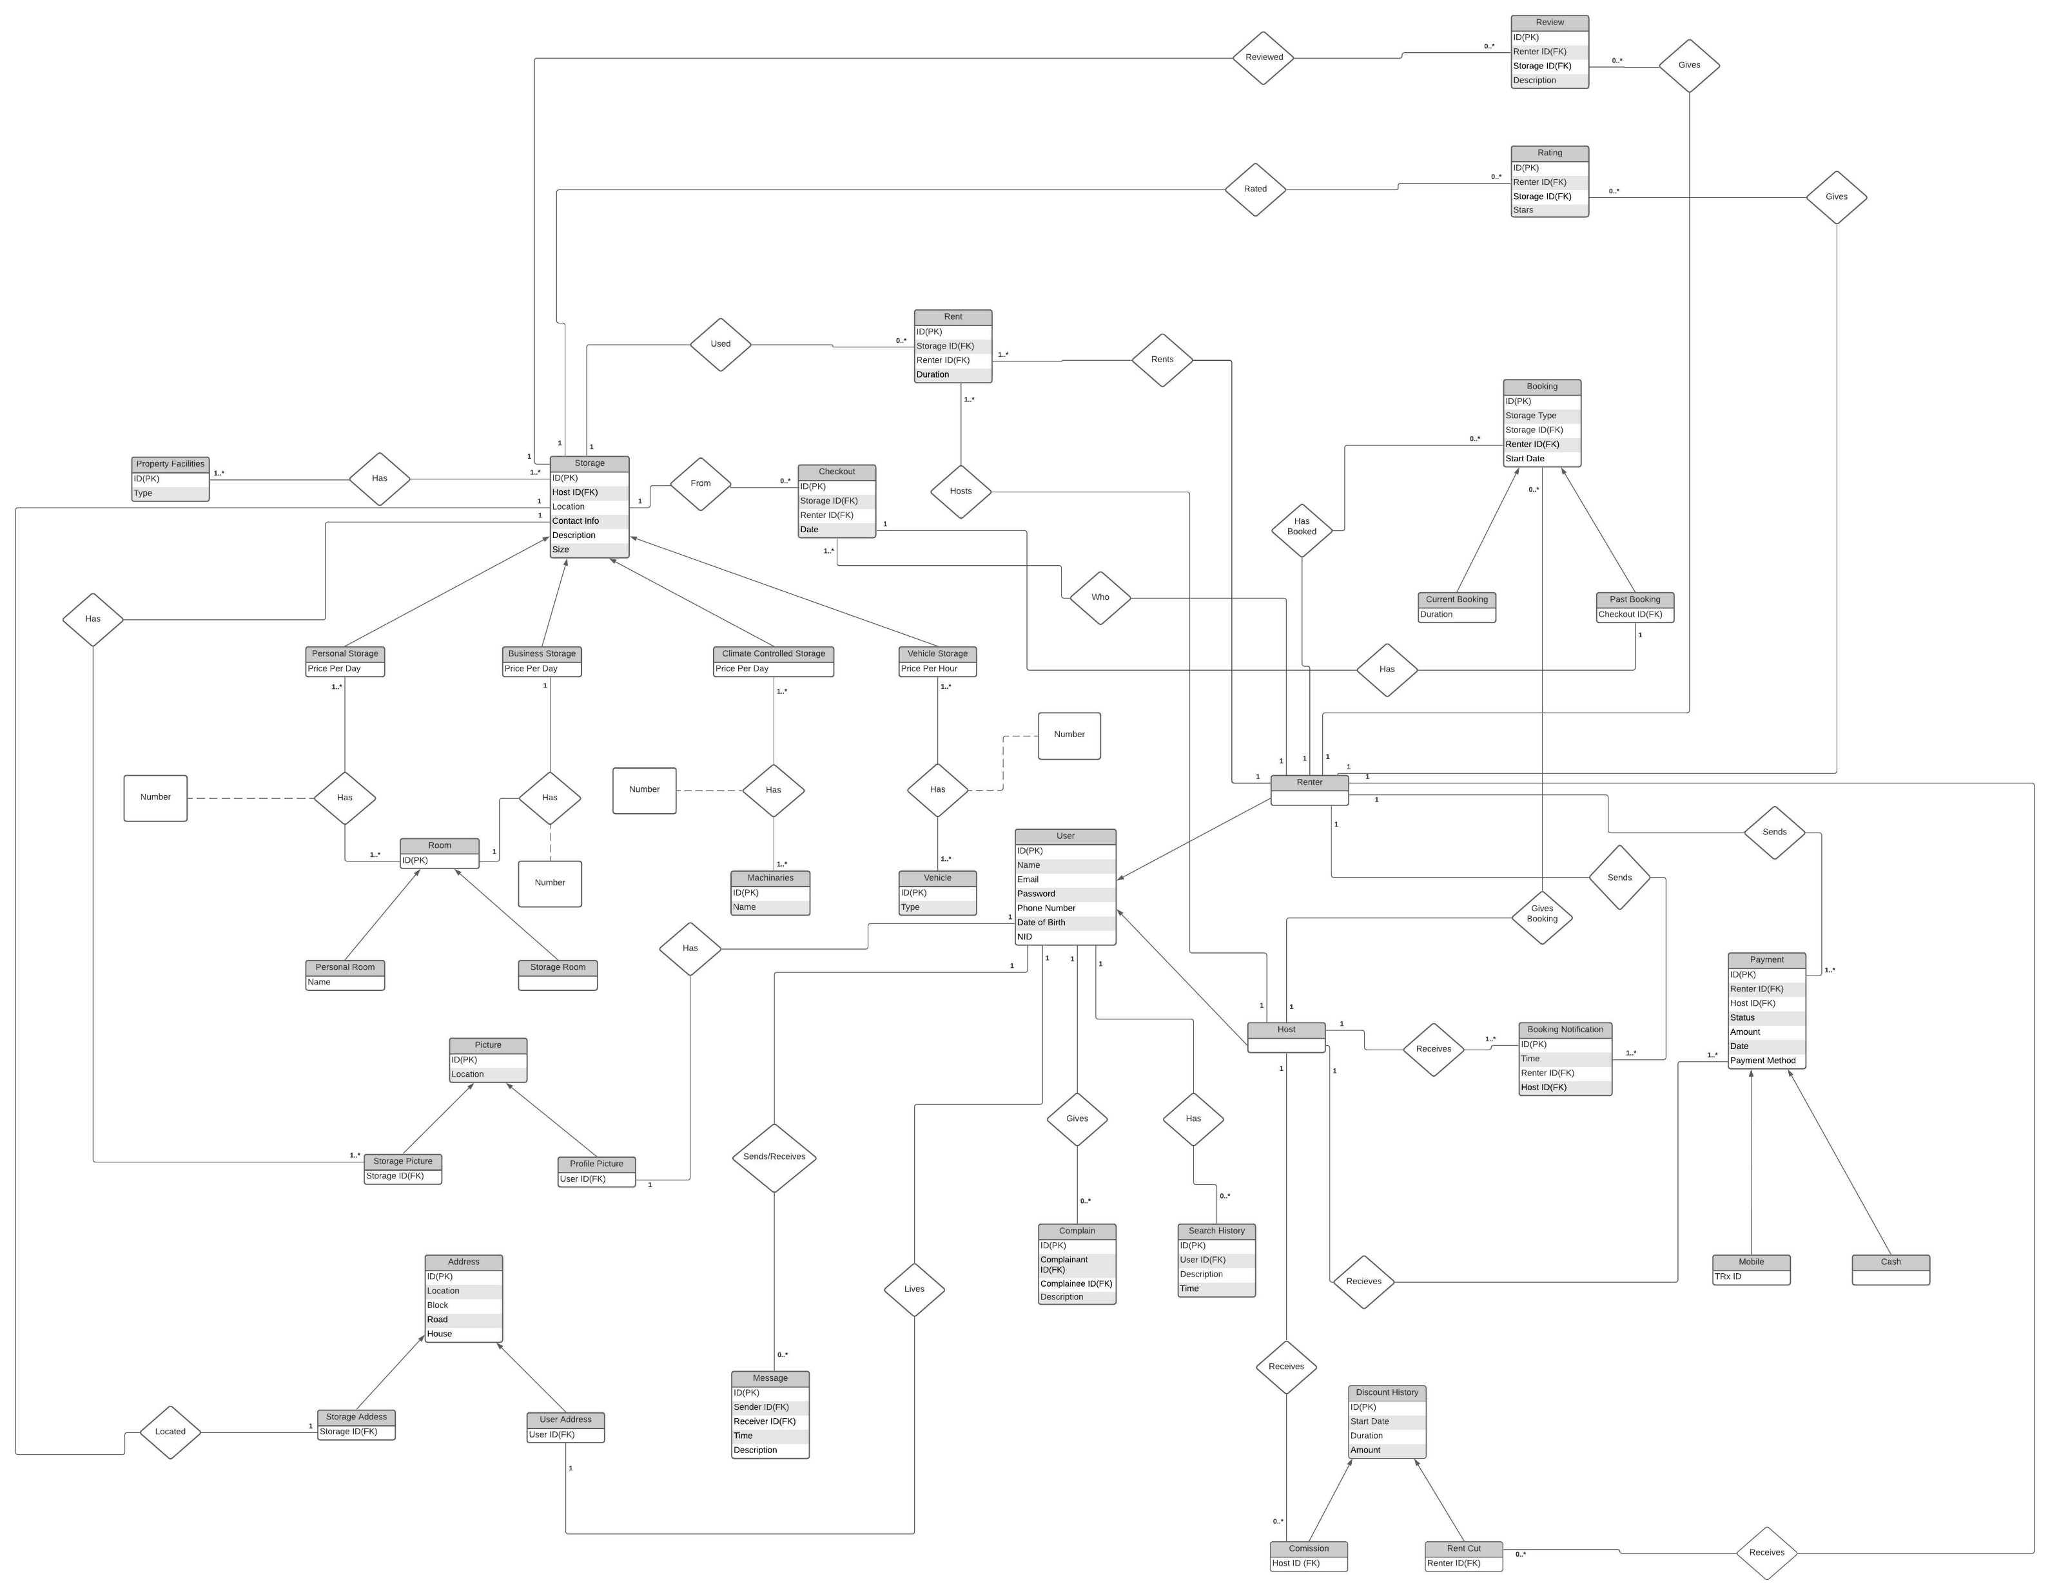
Whole ERD

Slide 3
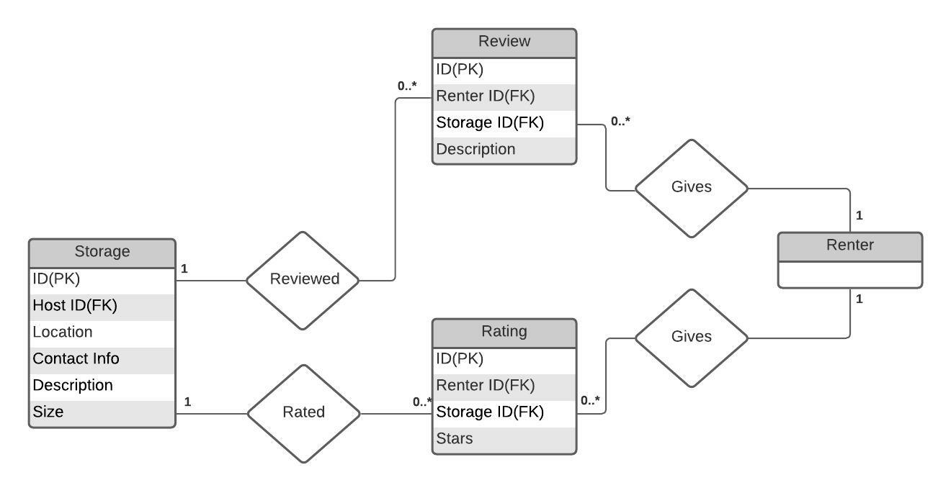
Review & Rating

Slide 4
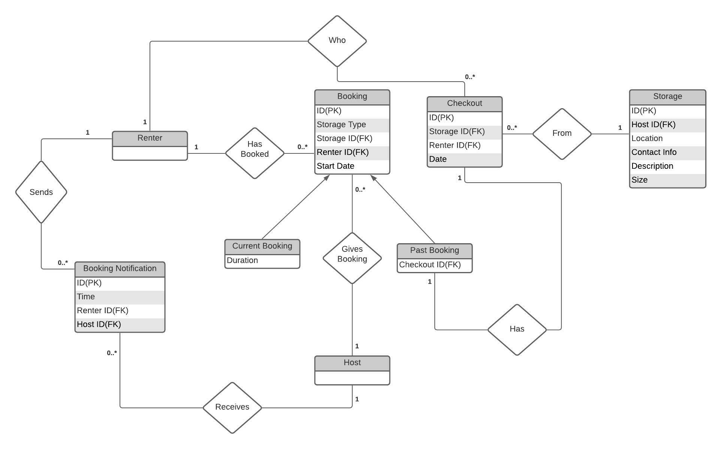
Booking, Booking Notification & Checkout

Slide 5
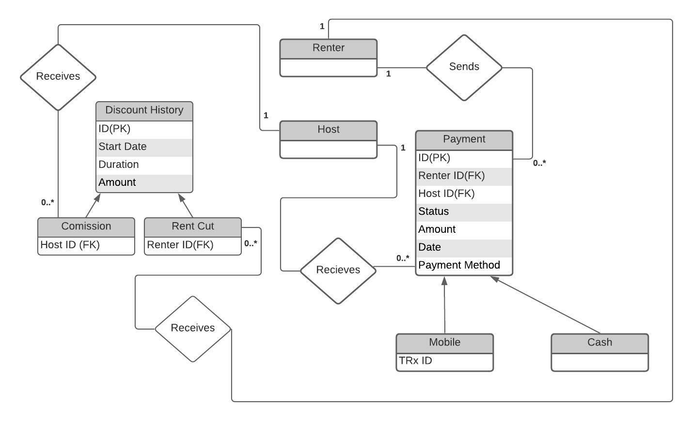
Discount History & Payment

Slide 6
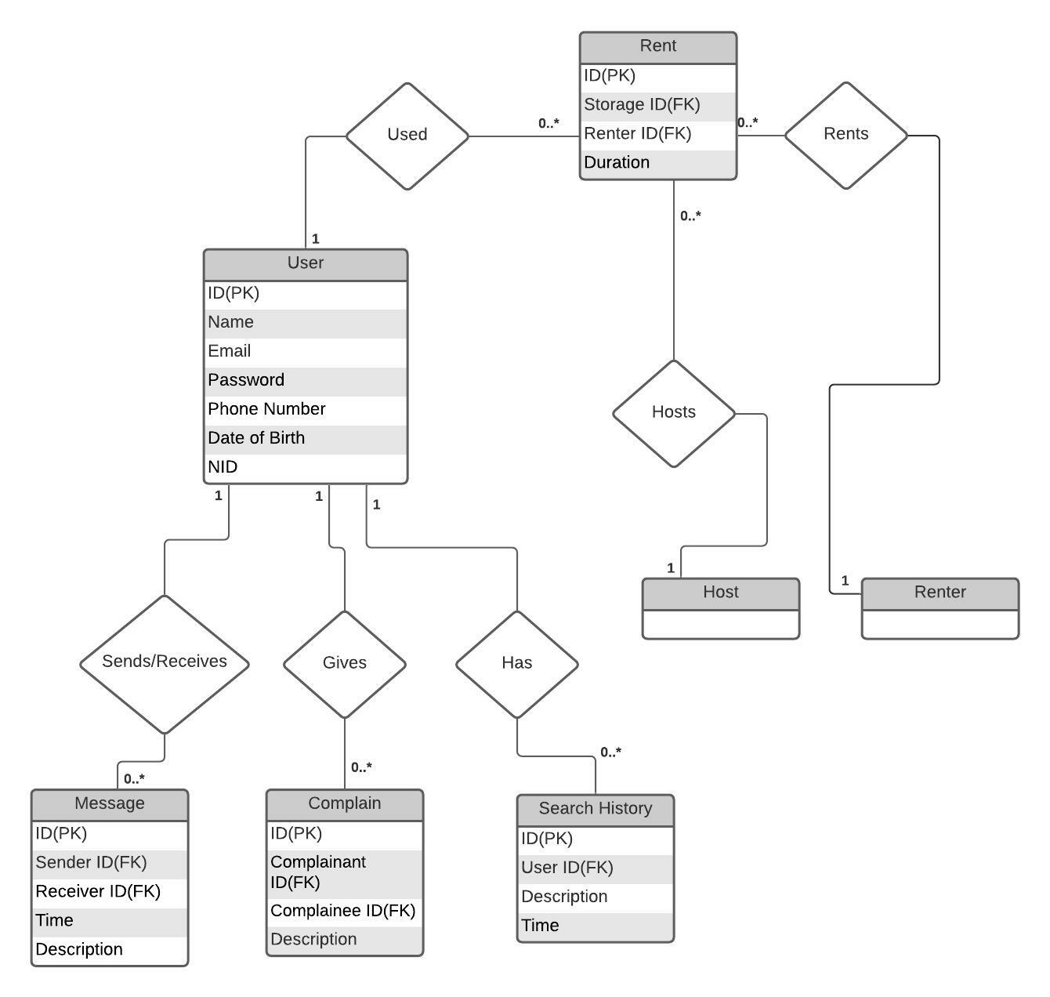
Rent, Message, Complain & Search History

Slide 7
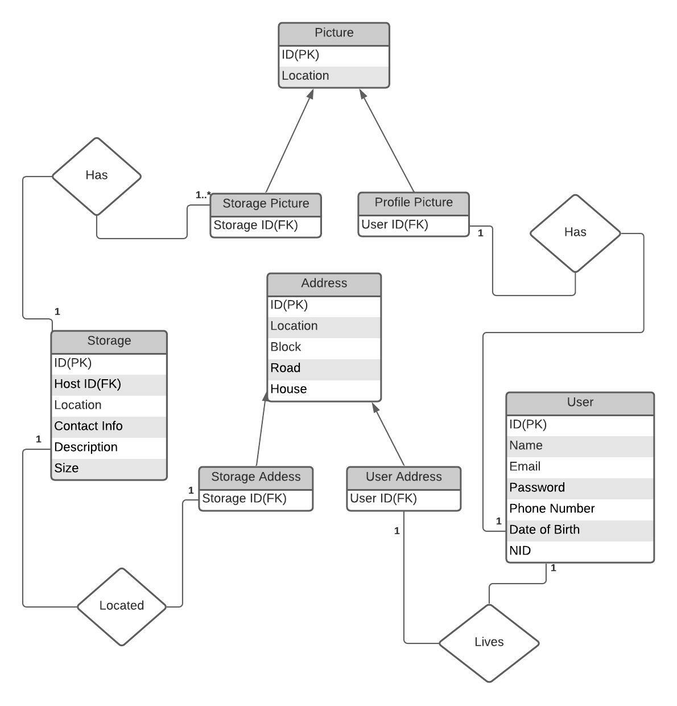
Picture & Address

Slide 8
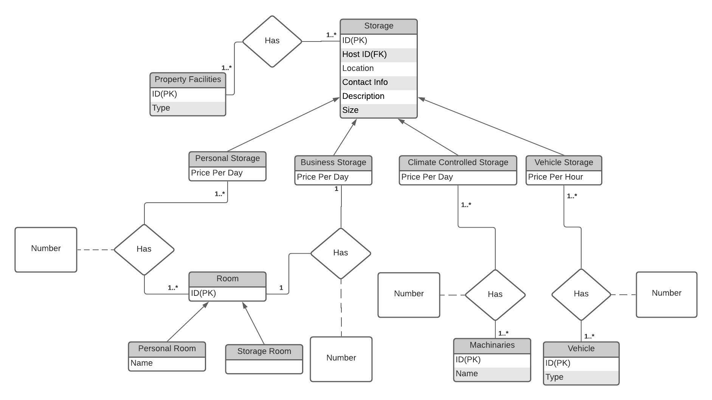
Storage & Related Entities

Slide 9
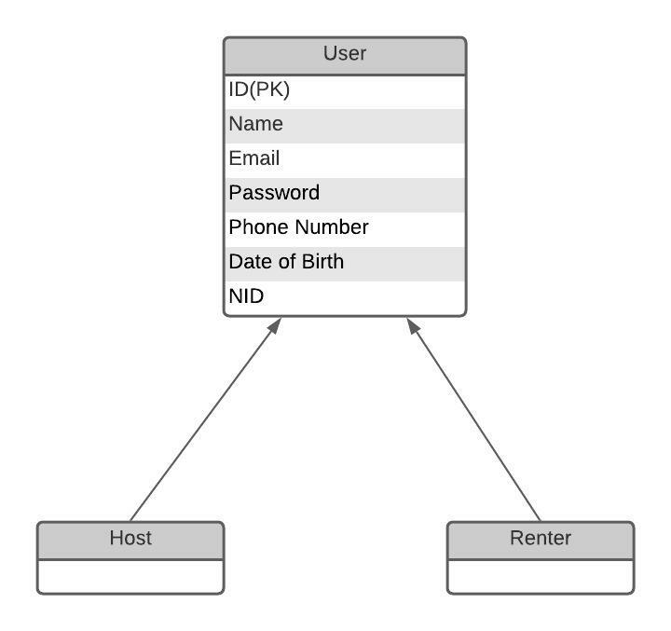
User

Slide 10
THANK YOU

